Slide 1

SC Quantathon V1 - 2024 Xanadu Challenge
Up and Atom (Team 8)

Slide 2
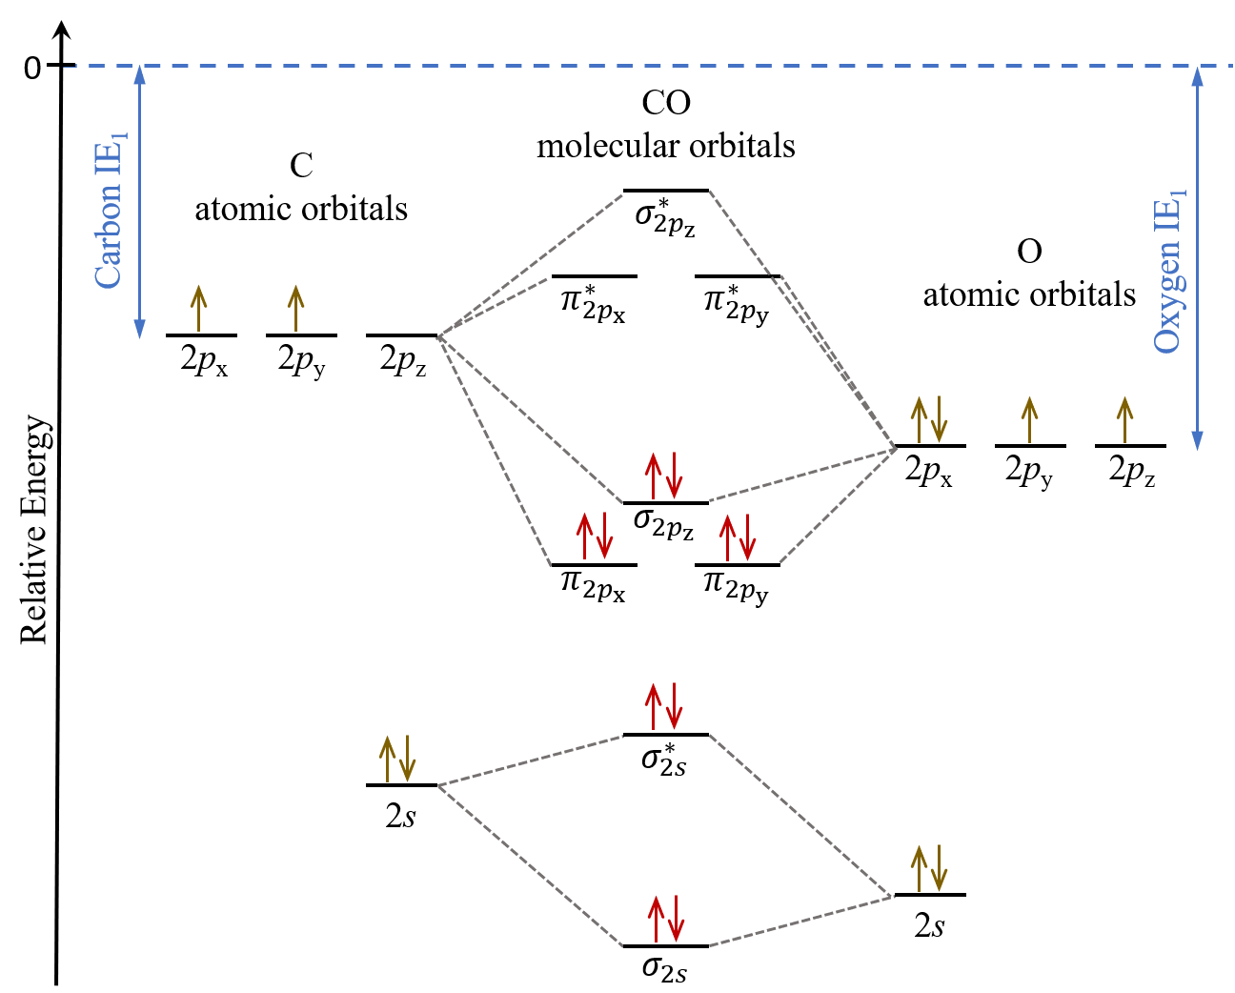
The Xanadu Challenge
Find the spectral gap of a molecule using Pennylane as the main quantum framework.
The spectral gap is the difference between the ground state and lowest excited state.

Slide 3
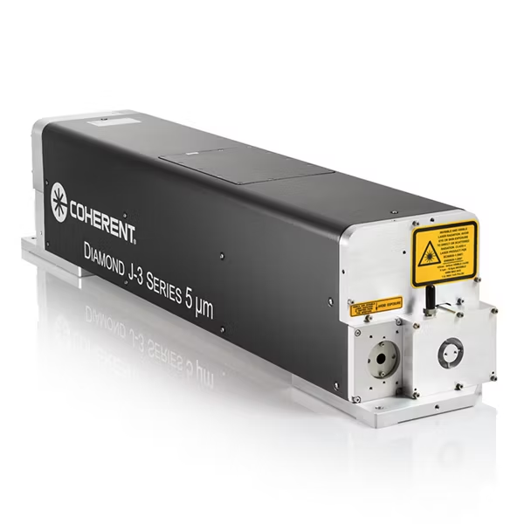
Spectral Gap of CO
A large spectral gap limits the central wavelengths of CO lasers¹
Calculation can help profile candidate materials for next generation lasers
Image Credit: Coherent Diamond Laser

Slide 4
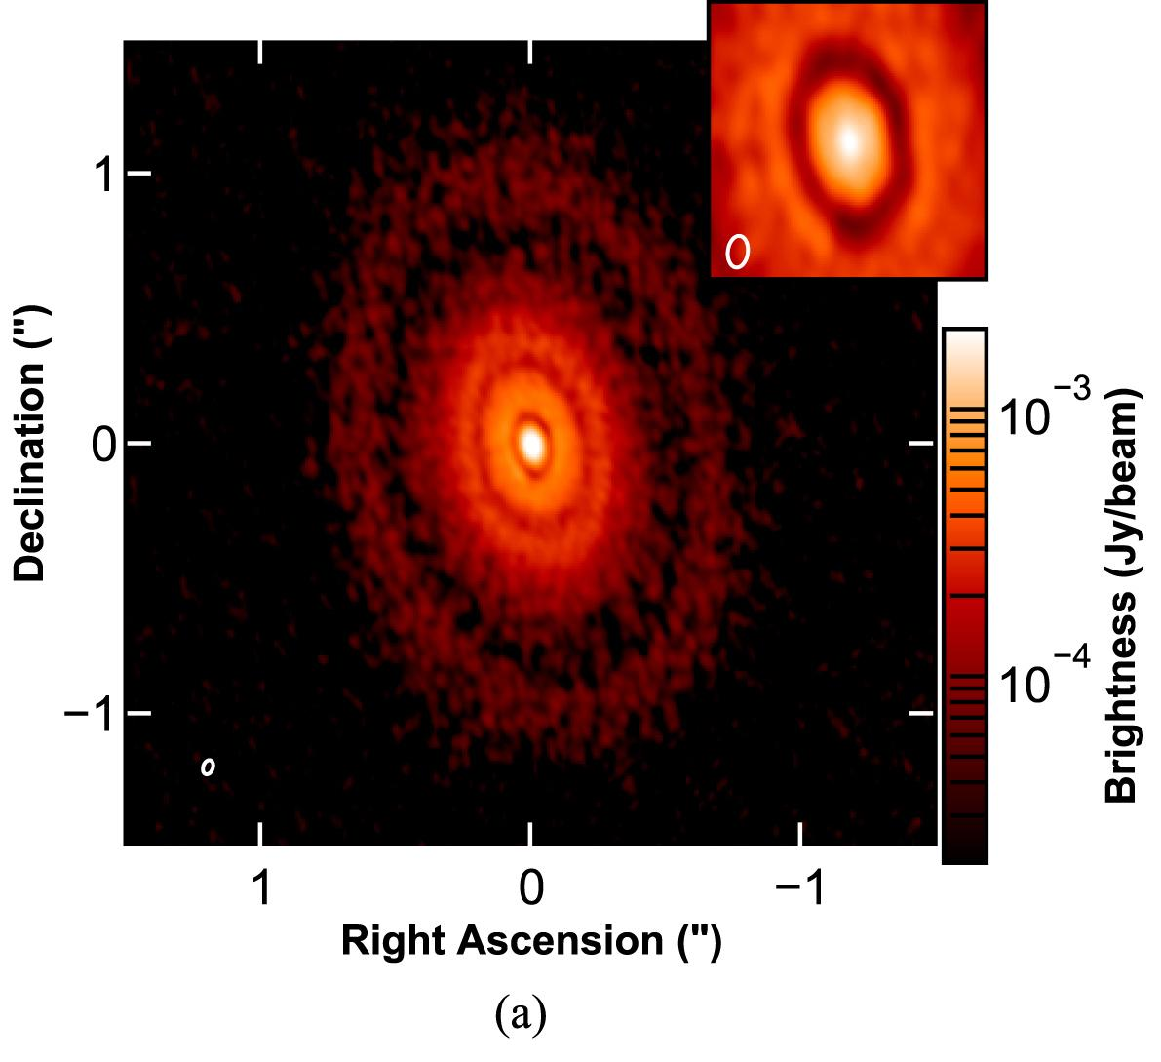
Spectral Gap of CO
Astrophysicists use the state transitions of CO as a marker for dust distribution in protoplanetary disks in order to study the theory of planetary formation^{2,3}.

Slide 5
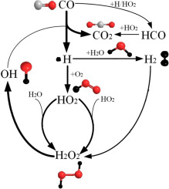
Spectral Gap of CO
With its status as an indirect contributor to the greenhouse gas concentration in the atmosphere, understanding the spectral energies of Carbon Monoxide allows for more accurate estimations of its abundance in the atmosphere, allowing for more accurate predictions of climate change models⁵.

Slide 6
The Algorithm
VQE: The Variational Quantum Eigensolver algorithm in PennyLane for finding the the ground state energy of CO.
VQD: Variational Quantum Deflation algorithm in PennyLane to find the first excited state energy of CO.
Adaptive Optimization: Detecting and removing gates which do not significantly impact the molecule’s energy.

Slide 7


VQE vs. VQD
VQE
Minimize energy
VQD
Minimize energy and ground state overlap

Slide 8
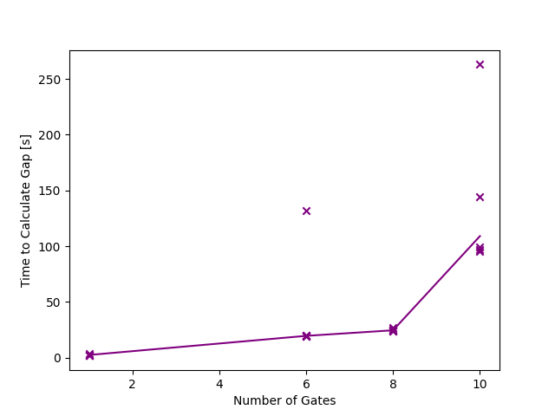
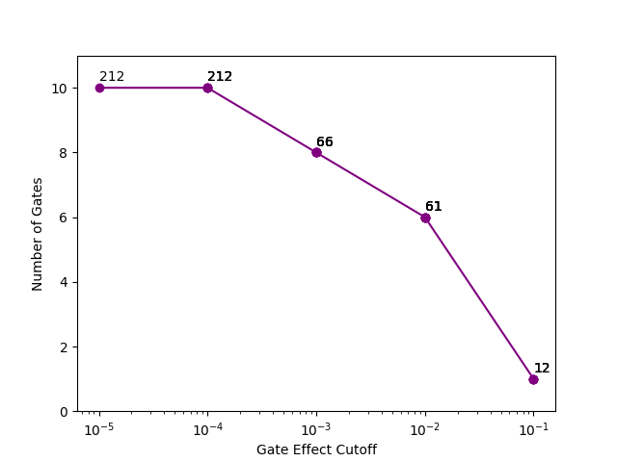
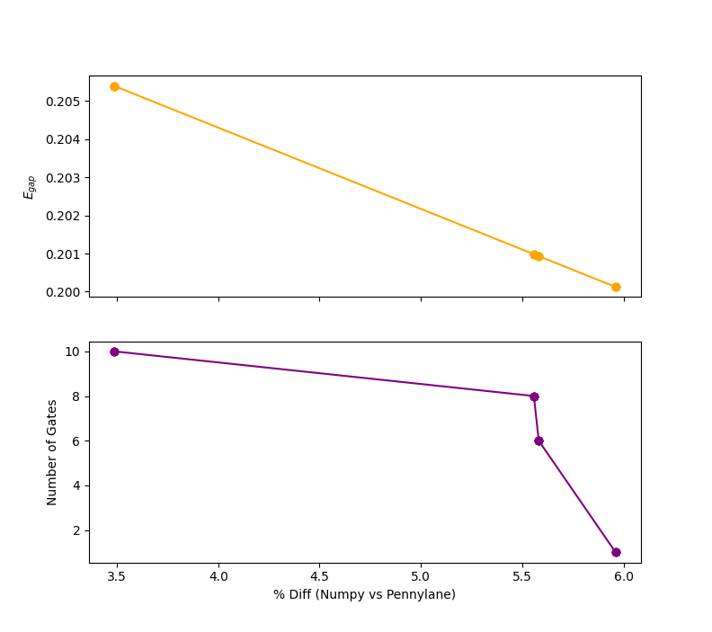
Optimization

Slide 9
The Algorithm: Hyperparameters
No. of active electrons:
More electrons increase accuracy at the cost of increased runtime. Generally, core electrons can be neglected.
No. of active orbitals:
More orbitals increases accuracy and the # of qubits. For low excited states, the uppermost orbitals can be neglected.
# qubits = 2 * # orbitals
Beta:
Coefficient of penalty term in VQD, has to be tuned to be on the order of the bandgap.

Slide 10
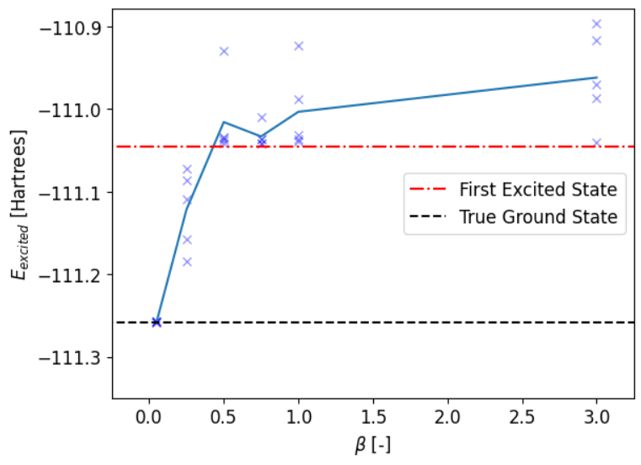
Performance: Energy vs. Beta
Beta too low = slow convergence / convergence to ground state
Beta too high = slow convergence / convergence to higher excited states

Slide 11
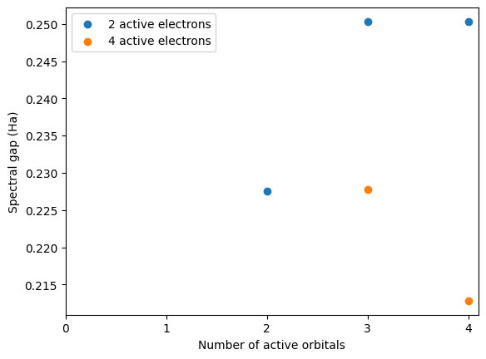
Performance: Spectral gap vs. Active Orbitals

Slide 12
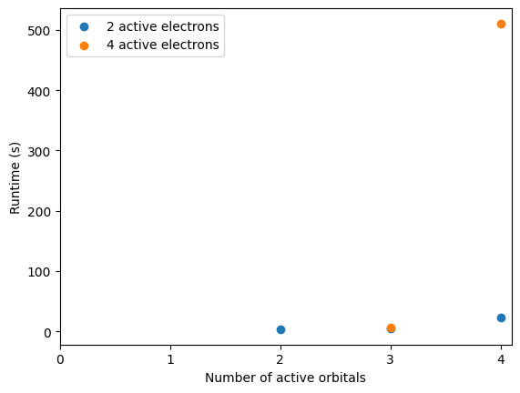
Performance: Runtime vs. active Orbitals

Slide 13
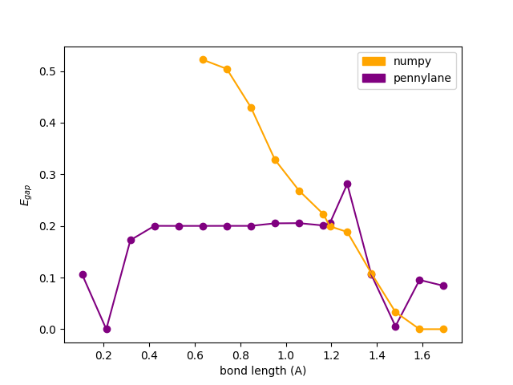
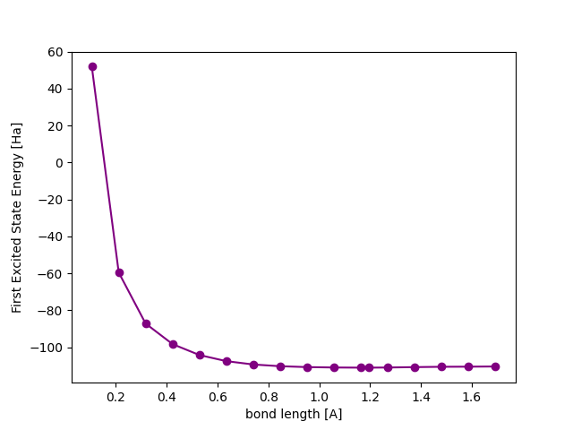
Energy vs Bond Length

Slide 14
Performance: Experimental Comparison
The experimental band gap energy is 6.04 eV
Our bandgap for R = 2.12, 4 active electrons and 4 active orbitals is 0.213 Hartree or 5.79 eV
A 4% error between experiment and theory!!

Slide 15
Future Work / Improvements
Adjust the optimizer!
Basin hopping for better convergence at non-optimal beta
For real quantum hardware, a derivative- free optimizer -> better noise tolerance
Adjust adaptive circuit for excited state
The excited state’s energy may depend on gates in a different way than the ground state’s energy. Circuit can be reoptimized for the excited state!
Notes:
Dependence of runtime on initial state

Slide 16
Conclusions
We successfully calculated the band gap of Carbon Monoxide using an adaptive VQE and VQD algorithm
Restricting the active electrons and orbitals accelerates calculations while maintaining accuracy

Slide 17
References
[1] https://opg.optica.org/ol/fulltext.cfm?uri=ol-37-14-2838&id=239663
[2] https://www.aanda.org/articles/aa/full_html/2013/06/aa21381-13/aa21381-13.html
[3] Kozdon, J., Brittain, S. D., Fung, J., Kern, J., Jensen, S., Carr, J. S., Najita, J. R., & Banzatti, A. (2023). Rovibrational Spectroscopy of CI Tau—Evidence of a Multicomponent Eccentric Disk Induced by a Planet. The Astronomical Journal, 166(3), 119. https://doi.org/10.3847/1538-3881/ace903
[4]https://science.nasa.gov/science-research/earth-science/atmospheric-composition/fourteen-years-of-carbon-monoxide-from-mopitt/
[5] http://www.ghgonline.org/otherco.htm

